Slide 1
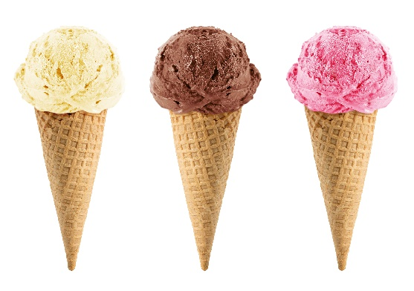

Analysis of Performance of a Radiation-Hard, Highly-Segmented Shashlik Electromagnetic Calorimeter in the CERN H4 Testbeam
Jet Flavor Identification with Machine Learning
Eric Culbertson
University of Virginia
Dec 16, 2016
Eric Culbertson
University of Virginia
Nov 10, 2016

Slide 2
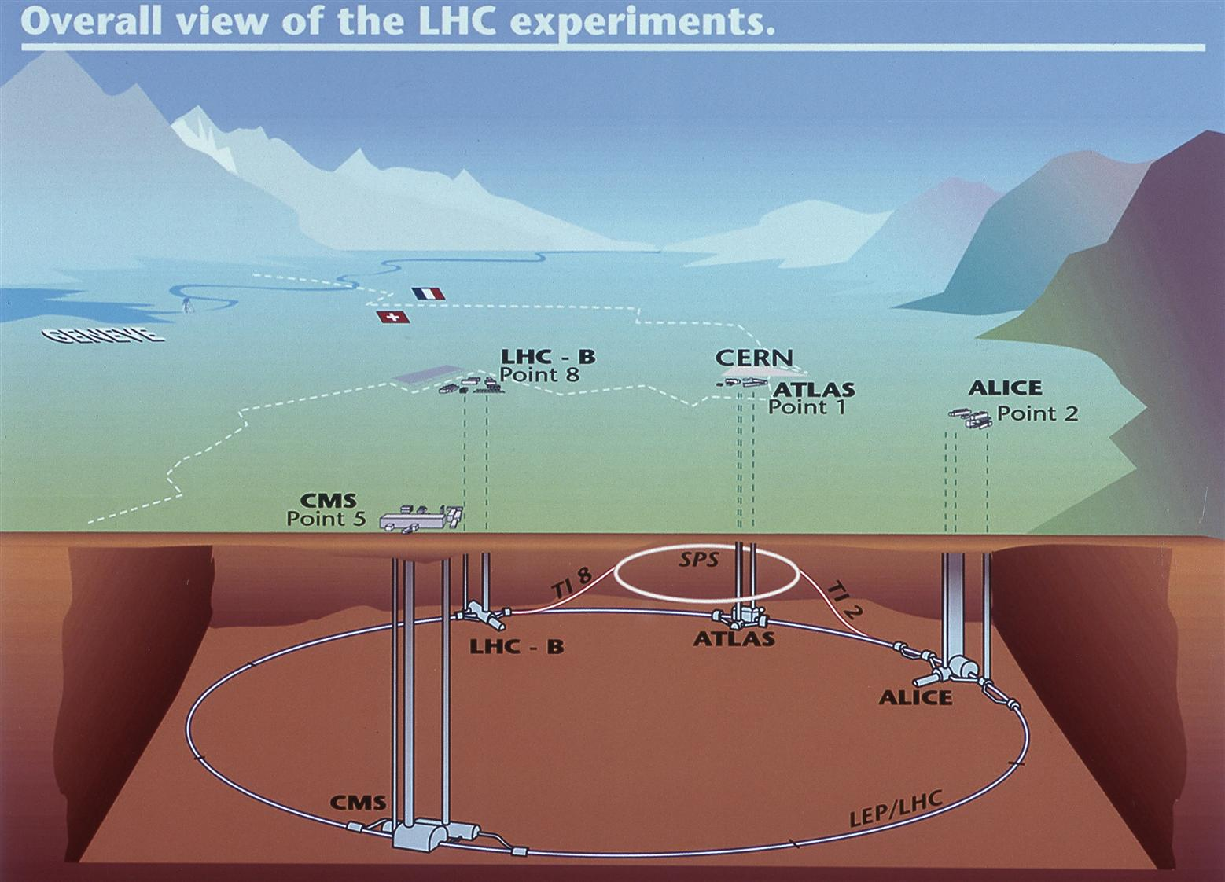
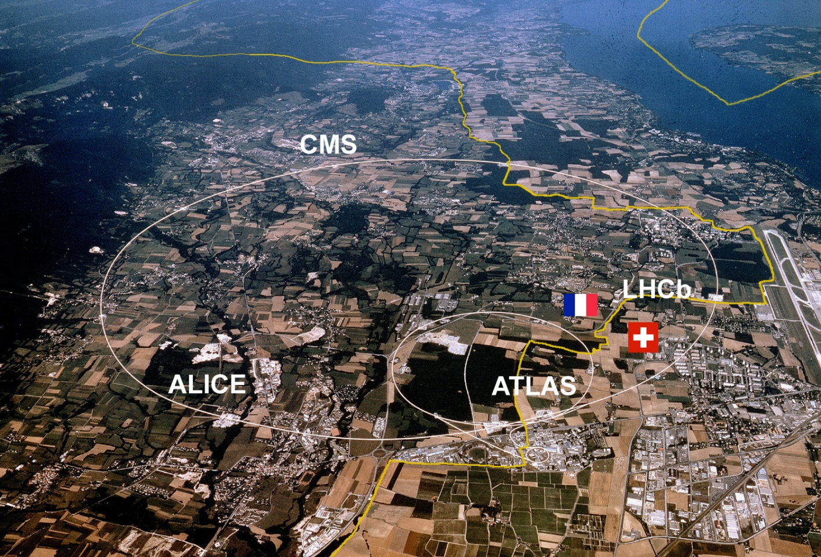
What is the Large Hadron Collider?
Eric Culbertson

Slide 3
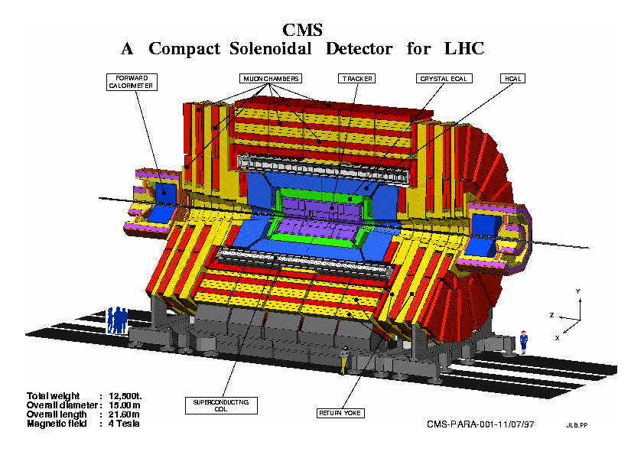
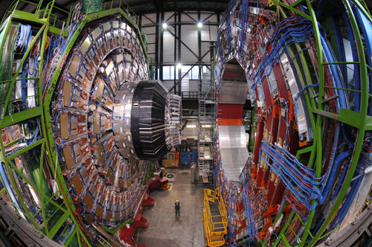
The CMS Detector
Eric Culbertson

Slide 4
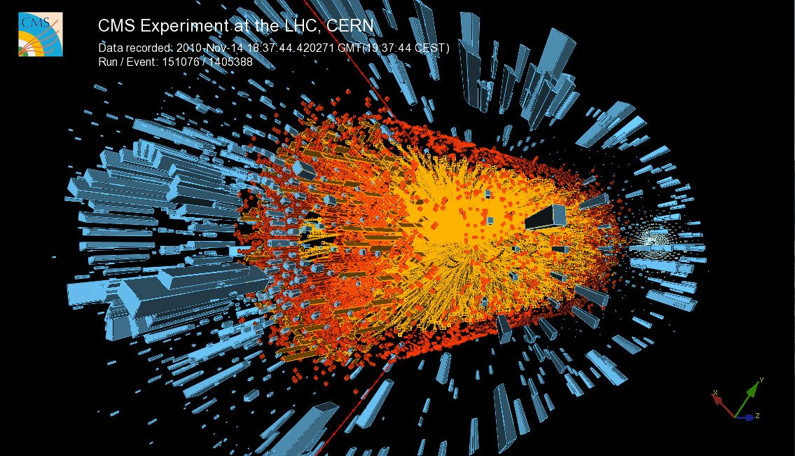
Eric Culbertson

Slide 5
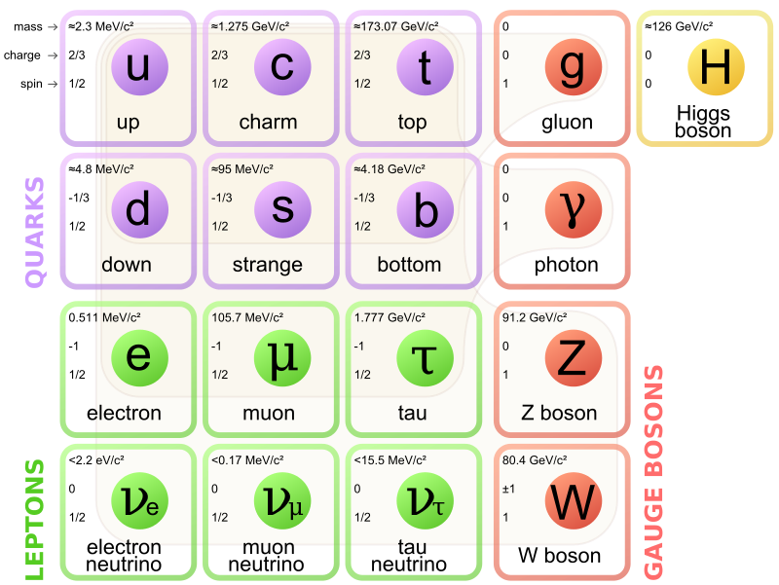
Brief physics overview…
4 Fundamental Forces
Weak
Strong
Gravitational
Electromagnetic
Eric Culbertson

Slide 6
Brief physics overview…
Hadrons are particles that can interact with the strong force!
The strong force prevents these particles from existing independently
Eric Culbertson

Slide 7
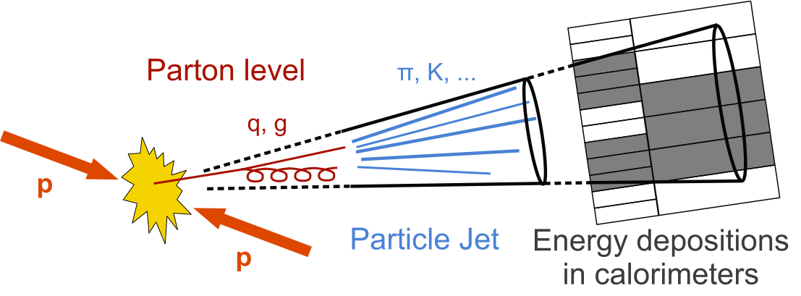
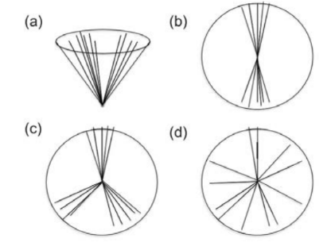
Jets
Due to the strong force, lone hadrons create a shower of particles in their direction
Eric Culbertson

Slide 8
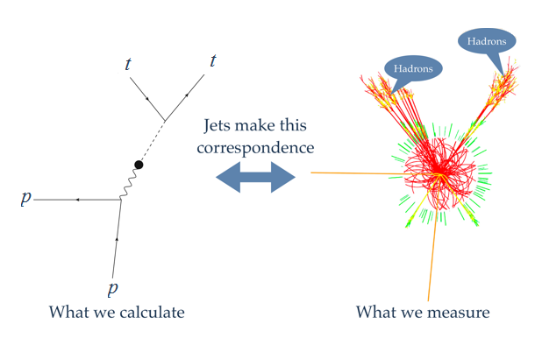
Jets
Jets make “simple” processes much trickier to detect
We need an effective way to distinguish between different kinds of jets
Eric Culbertson

Slide 9
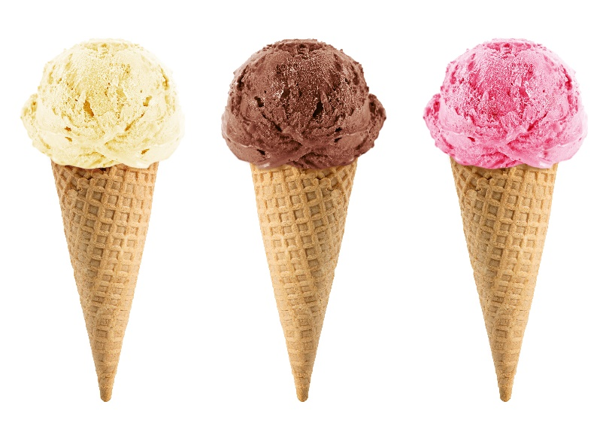
Jet Flavors
The flavor refers to the source particle of a jet
Light flavor – up, down, strange quark
Top flavor
Gluon flavor
Eric Culbertson

Slide 10


Making the Test Sample
I used Monte Carlo simulations to generate my data for this project
Multiple software packages were used to generate the initial hadrons and then the following jets
I chose to generate the tt+jj process, where the proton collision produces 2 top quarks + 2 other hadrons
Eric Culbertson

Slide 11
Matching the jets
MadGraph gives the trajectories of the initial particles (tt+jj)
Pythia + FastJet gives me the trajectory of the resulting jets
I matched each jet to an initial particle by picking out particle/jet pairs that are going very closely in the same direction
Eric Culbertson

Slide 12
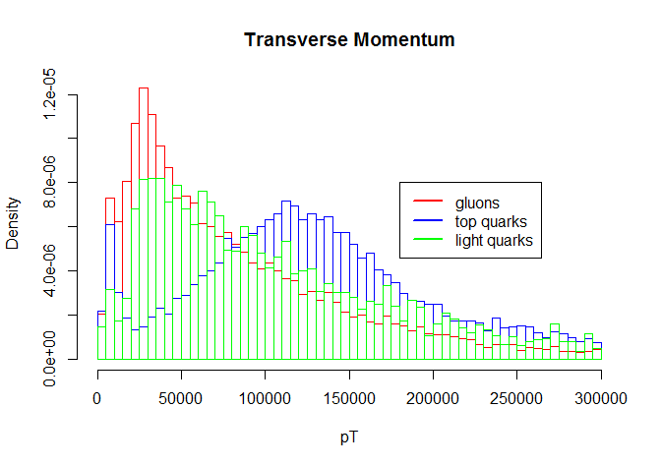
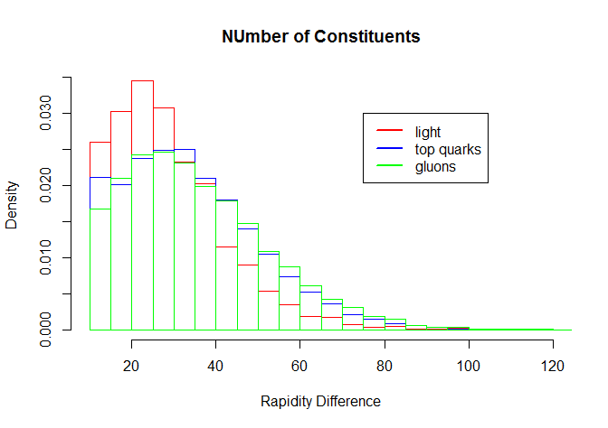
Qualitative Look
Most attributes have very similar distributions…
Eric Culbertson

Slide 13
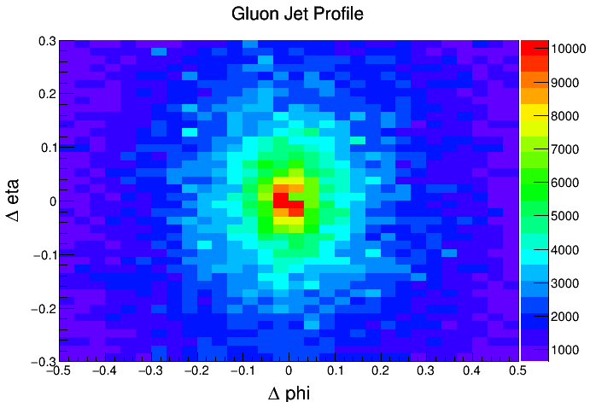
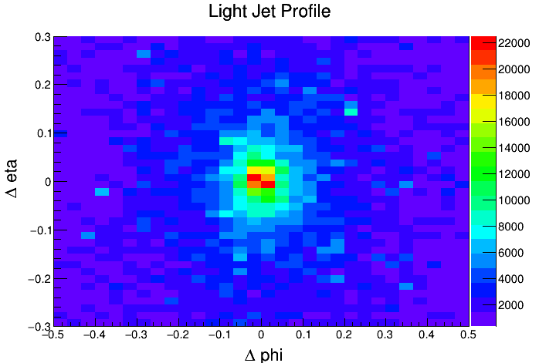
Jet Structure
Plotting the distributions of a jet constituents reveals the difference in structure between flavors
Eric Culbertson

Slide 14
Feature Engineering
Simulation output mainly gives direction and energy information of jet
Using the information of a jet’s constituents, I can determine how spread out a jet is
I included multiple variables meant to measure this attribute
Eric Culbertson

Slide 15
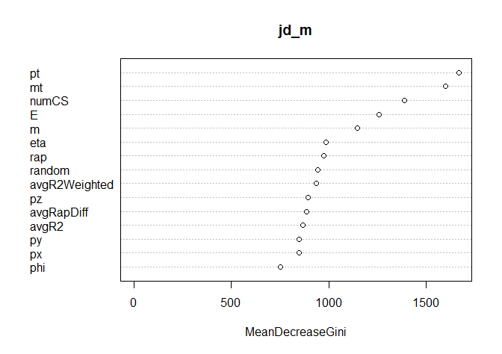
Attribute Importance
Added a random column for reference
Removed most attributes that performed worse than the random column
Eric Culbertson

Slide 16
Attribute Importance
Added a random column for reference
Removed most attributes that performed worse than the random column
Eric Culbertson

Slide 17
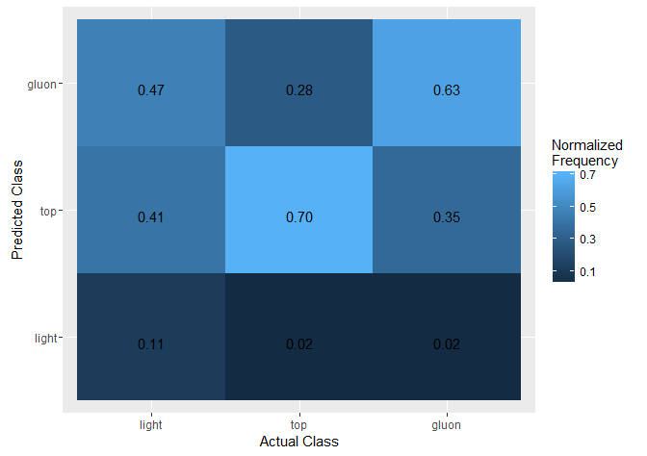
Performance
All algorithms tested (C5.0, knn, Jrip) had similar performance
The models hardly ever predicts that a jet comes from light quarks
Performance on other classes is relatively good
Eric Culbertson

Slide 18
Improving this Performance
Need to engineer attributes that discriminate light jets
My sample size was quite small (16,000 total jets) by physics standard, so this could be improved
There’s potential for this project take advantage of deep learning methods
Eric Culbertson

Slide 19
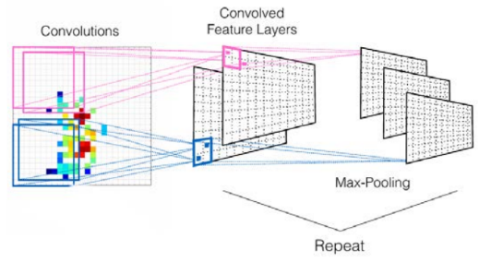
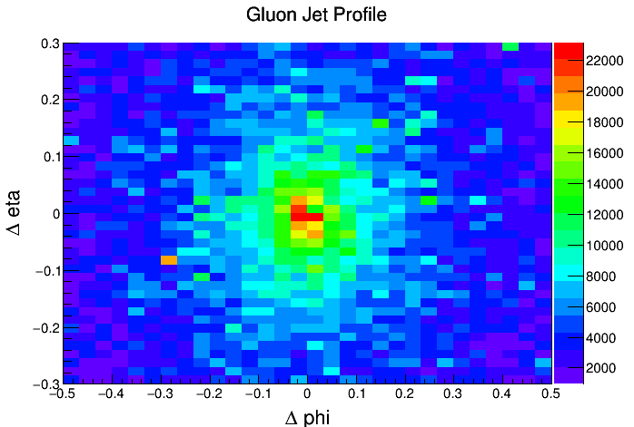
Deep Neural Networks
I can turn my 2D hists into images, where each bin in the histogram represents a pixel.
A convolutional neural network can then learn the general structures
Eric Culbertson

Slide 20
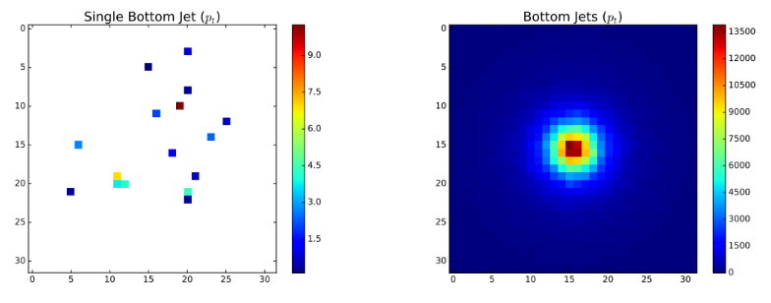
Deep Neural Networks
The neural network would need to classify a rather sparse jet distribution (left)
Picture taken from another jet study with higher statistics
Eric Culbertson

Slide 21
Conclusions
Currently, my attempts at machine learning have mixed results
Top/gluon jet discrimination performs well,
Light jet discrimination performs very poorly
My project has potential to use deep neural networks to improve results
More closely examines jet structure
Eric Culbertson

Slide 22
Next steps
Create more images and train neural network
Apply particle decay to my dataset to add more realism
This breaks up my “top flavor” into bottom and charm flavors
Switch from 4-flavor scheme to 5-flavor scheme at generation
Add detector simulation to my dataset
Eric Culbertson

